Slide 1
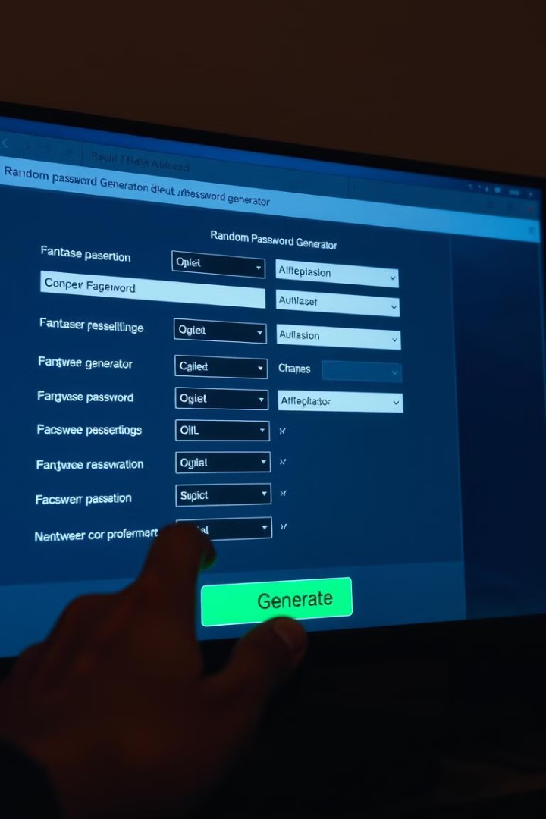
Random Password Generator
A random password generator is a valuable tool for protecting online accounts and sensitive information from unauthorized access.
VS
by VENKATESH S

Slide 2

Why use a random password generator?
1
Stronger Passwords
2
Unique Passwords
Randomly generated passwords are harder to guess than predictable ones.
Using different passwords for different accounts mitigates the risk of compromise.
3
Improved Security
4
Convenience
A secure password is a crucial line of defense against cyber threats.
Generates passwords with minimal effort, saving time and reducing frustration.

Slide 3
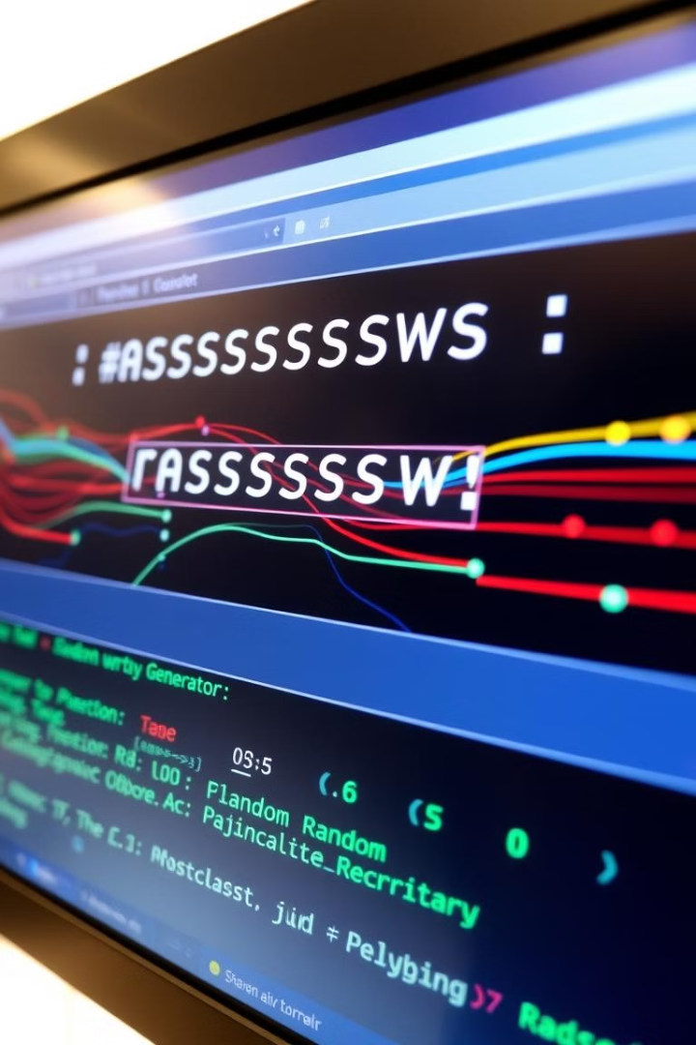
How do random password generators work?
1
Character Selection
Generators choose random characters from a pool of letters, numbers, and symbols.
2
Length Determination
They generate passwords with specific lengths, often based on user preferences.
3
Password Generation
They combine selected characters to form a unique and random password.

Slide 4
Factors to consider when generating a password
Length
Complexity
Uniqueness
Longer passwords are generally more secure. Aim for at least 12 characters or more.
Include a mix of uppercase and lowercase letters, numbers, and symbols for enhanced security.
Use a different password for each online account to prevent compromise.

Slide 5
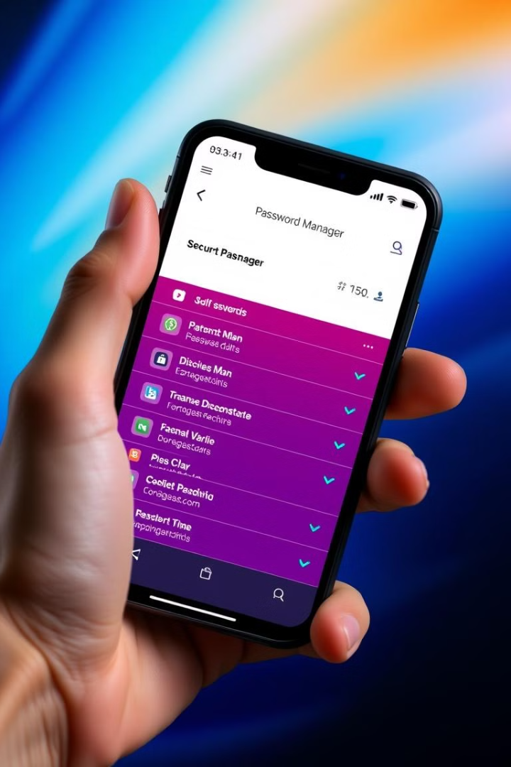



Best practices for using random passwords
Use a Password Manager
Password managers securely store your passwords, eliminating the need to remember them.
Enable Two-Factor Authentication
Add an extra layer of security by requiring a second factor of authentication, like a code sent to your phone.
Avoid Common Words
Don't use words found in dictionaries or common phrases as passwords.

Slide 6
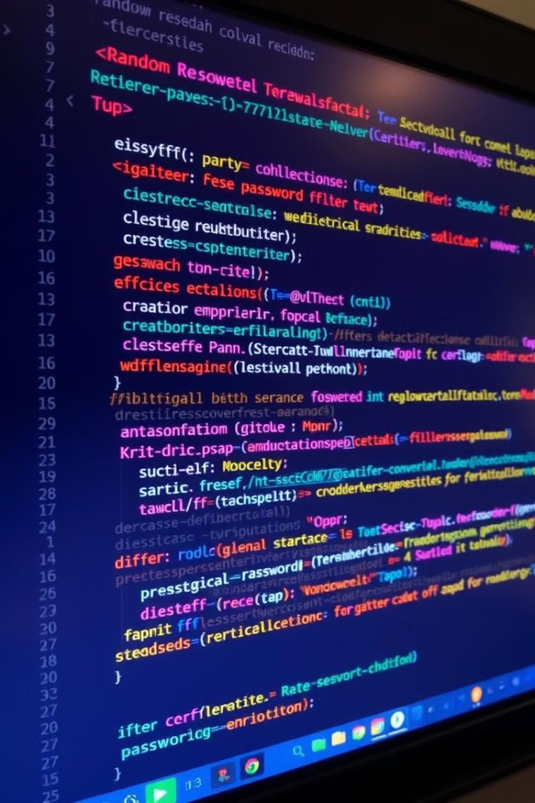
Implementing a random password generator
**Language Selection**
Choose a language that provides random number generation and character manipulation capabilities.
**Character Set**
Define a set of characters to be used in the password, including letters, numbers, and symbols.
**Randomization**
Utilize a robust random number generator to ensure the unpredictability of the password.
**Length Control**
Implement a mechanism to control the length of the generated password.

Slide 7
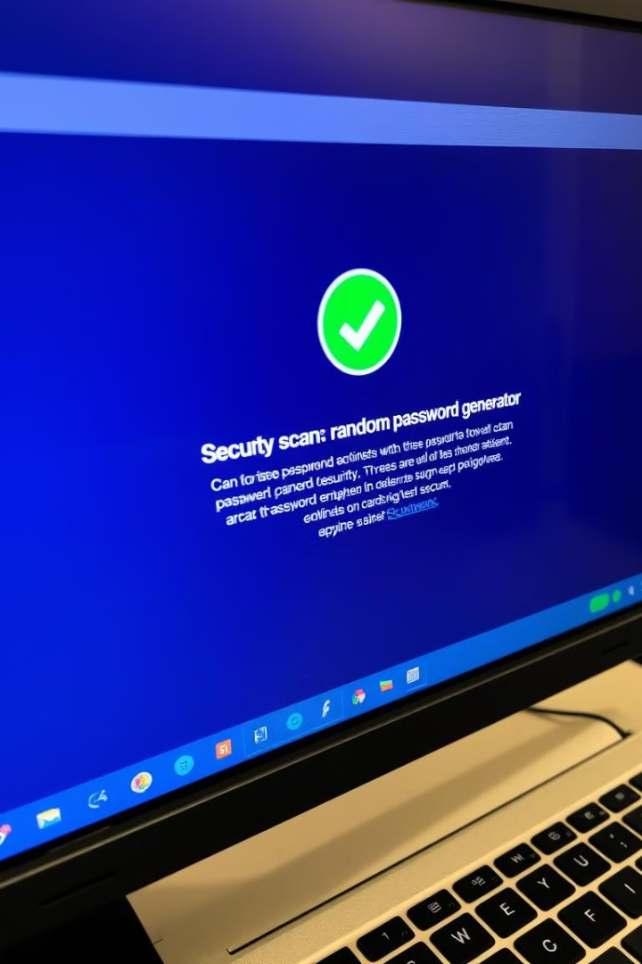




Securing your random password generator
Input Validation
Secure Storage
Validate user input to prevent malicious code injection or unexpected behavior.
Store generated passwords securely to prevent unauthorized access.
Encryption
Regular Testing
Encrypt passwords during storage and transmission to protect them from eavesdropping.
Conduct regular security audits and vulnerability assessments to identify and fix potential weaknesses.

Slide 8

The future of password security
Biometric Authentication
Passwordless Authentication
Using unique biological traits, such as fingerprints or facial recognition, for authentication.
Moving towards alternative authentication methods, like passkeys or security keys, that don't rely on passwords.
AI-Powered Security
Leveraging artificial intelligence to detect and prevent malicious activity, enhancing security measures.

